Slide 1
Encapsulation

Slide 2
Objectives
Class and Object
How to identify classes
Hints for class design
How to declare/use a class
Member functions
Common modifiers (a way to hide some members in a class)
Case study
Reference to Design Pattern in Java , SOLID principles, and OCP(Open – Close principle)
(https://www.javatpoint.com/design-patterns-in-java)

Slide 3
Encapsulation
Aggregation of data and behavior.
Class = Data (fields/properties) + Methods
Data of a class should be hidden from the outside.
All behaviors should be accessed only via methods.
A method should have a boundary condition: Parameters must be checked (use if statement) in order to assure that data of an object are always valid.
Constructor: A special method it’s code will execute when an object of this class is initialized.
Getters/Setters: implementing getter and setter is one of the ways to enforce encapsulation in the program’s code.

Slide 4
How to Identity a Class
Main noun: Class
Nouns as modifiers of main noun: Fields
Verbs related to main noun: Methods
For example, details of a student include code, name, year of birth, address.
Write a Java program that will allow getCode(), setName(String name), getName() a student
Main noun: Student Auxiliary nouns:code , name, bYear, address; verbs: getCode() , setName(String name), getName()

Slide 5
Hints for class design
A UML class diagram is used to represent the Student class
Student
class
code: String name: String dateOfBirth: date address: String
fields
Student()
Student(code:String,name:String, dob:date, address:String)
getCode(): String setName(name:String):void
getName():String
toString():String
methods

Slide 6
How to Identity a Class
A company has a number of Employees. Employee attributes include: employee code, name, address, and date of birth. The company also carries out several projects. Project properties include: project name, project start date. Each employee is assigned to participate in one or more projects, or may not participate in any projects.

Slide 7
Hints for class design
Identifying classes: Coupling
Is an object’s reliance on knowledge of the internals of another entity’s implementation.
When object A is tightly coupled to object B, a programmer who wants to use or modify A is required to have an inappropriately extensive expertise in how to use B.
Head
High coupling
( Bad design)
Eye1
Eye2
Head
leftEye
rightEye
Eye
Eye
Low coupling
( Good design)

Slide 8
Hints for class design
Implementing methods: Cohesion is the degree to which a class or method resists being broken down into smaller pieces.
class A
M1()
{
}
M2()
{
}
M()
{ M1(); M2();
}
class A
M()
{
}
Operation 1
Operation 1
Operation 2
Operation 2
Low cohesion(bad design)
High cohesion(good design)

Slide 9
Declaring/Using a Java Class
[public] class ClassName [extends FatherClass] {
[modifier] Type field1 [= value];
[modifier] Type field2 [= value];
// constructor
[modifier] ClassName (Type var1,…) {
<code>
}
[modifier] Type methodName (Type var1,…) {
<code>
}
…….
}
Modifiers will be introduced later.
How many constructors should be implemented? ➔ Number of needed ways to initialize an object.
What should we will write in constructor’s body? ➔ They usually are codes for initializing values to descriptive variables

Slide 10

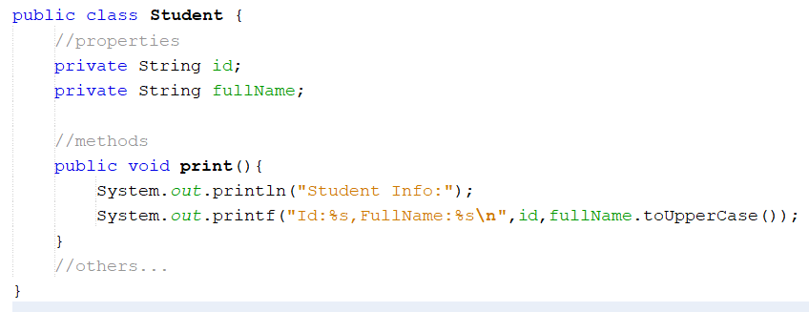
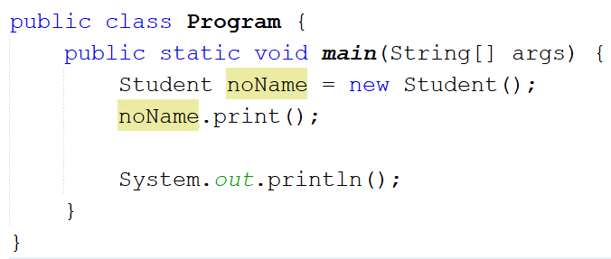
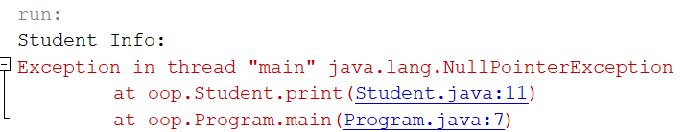
Demo : Create a class

Slide 11
Member functions: Constructors
Constructors that are invoked to create objects from the class blueprint.
Constructor declarations look like method declarations—except that they use the name of the class and have no return type.
The compiler automatically provides a no-argument, default constructor for any class without constructors.
Notes:
This default constructor will call the no-argument constructor of the superclass. In this situation, the compiler will complain if the superclass doesn't have a no-argument constructor so you must verify that it does. If your class has no explicit superclass, then it has an implicit superclass of Object, which does have a no-argument constructor.

Slide 12
Member functions: Constructors
//default constructor public Student(){ code=“SE123”; name=“Hieu”; bYear= 2000; address=“1 Ba Trieu , HN”. }
//constructor with parameters public Student(String code, String name, int bYear, String address){ this.code=code; this.name=name; this.bYear= year; this.address=address. }

Slide 13
The current object: this
The keyword this returns the address of the current object.
This holds the address of the region of memory that contains all of the data stored in the instance variables of current object.
Scope of this: this is created and used just when the member method is called. After the member method terminates this will be discarded

Slide 14
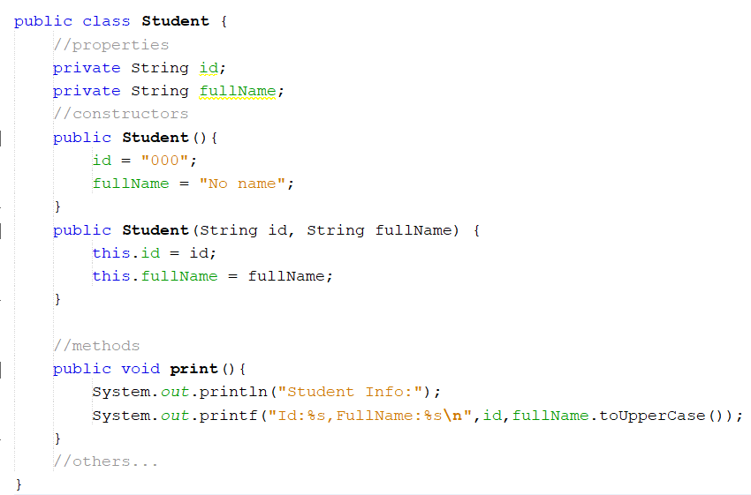
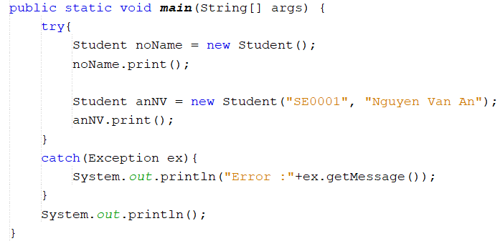
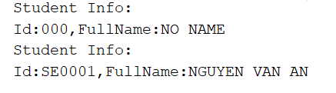
The current object: this
Update code Student.java
Update code Program.java

Slide 15
Member functions: Getter/Setter
A getter is a method that gets the value of a property.
A setter is a method that sets the value of a property.
Uses:
for completeness of encapsulation
to maintain a consistent interface in case internal details change

Slide 16
Member functions: Getter/Setter
For example: public String getName(){ return name; }
public void setName(String name){ if(! name.isEmpty()) this.name=name; }

Slide 17
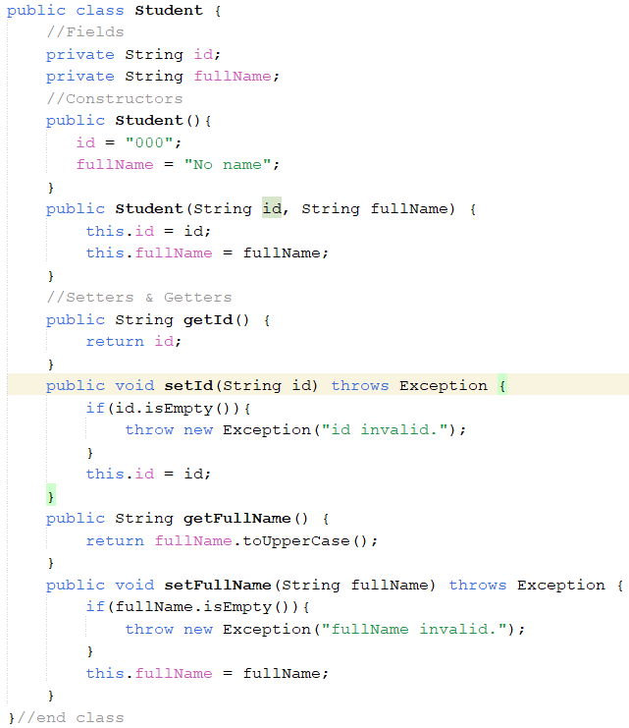
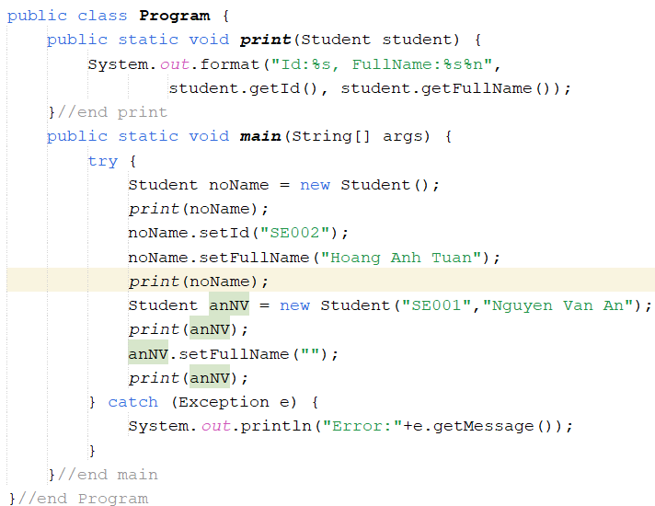

Member functions: Getter/Setter
Update code Student.java
Update code Program.java

Slide 18
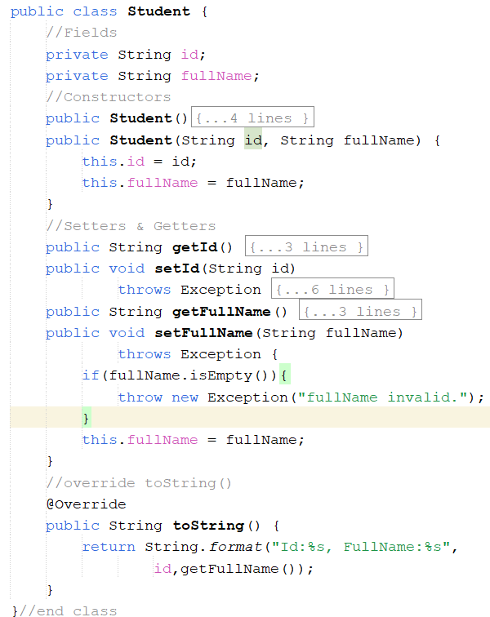
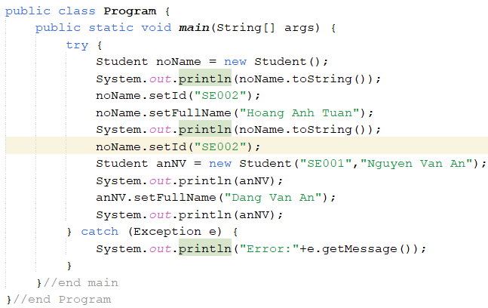

Member functions: toString()
Update code Student.java
Update code Program.java

Slide 19
Member functions: other methods
Typical method declaration:
[modifier] ReturnType methodName (params) {
<code>
}
Signature: data help identifying something
Method Signature:
name + order of parameter types

Slide 20
Member functions: other Methods
For example: public void input(){ //code here }
public void output(){ //code here
}

Slide 21
Passing Arguments a Constructor/Method
Java uses the mechanism passing by value. Arguments can be:
Primitive Data Type Arguments
Reference Data Type Arguments (objects)

Slide 22
Creating Objects
Class provides the blueprint for objects; you create an object from a class.
Student stu = new Student(“SE123”,”Minh”,2000,”1 Ba Trieu”);
Statement has three parts:
Declaration: are all variable declarations that associate a variable name with an object type.
Instantiation: The new keyword is a Java operator that creates the object (memory is allocated).
Initialization: The new operator is followed by a call to a constructor, which initializes the new object (values are assigned to fields).

Slide 23
Type of Constructors Create/Use an object of a class
Default constructor: Constructor with no parameter.
Parametric constructor: Constructor with at least one parameter.
Create an object
ClassName obj1=new ClassName();
ClassName obj2=new ClassName(params);
Accessing a field of the object
object.field
Calling a method of an object
object.method(params)

Slide 24
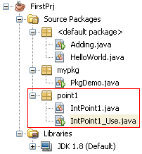
Demo: If we do not implement any constructor, compiler will insert to the class a system default constructor
In this demonstration (package point1):
The class IntPoint1 represents a point in an integral two dimensional coordinate.
The class IntPoint1_Use having the main method in which the class IntPoint1 is used.

Slide 25
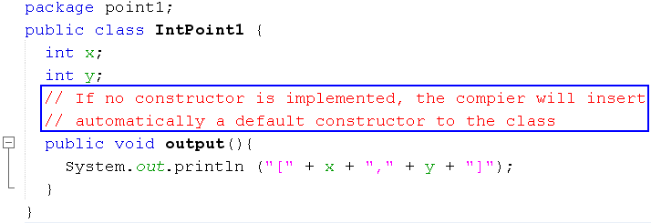
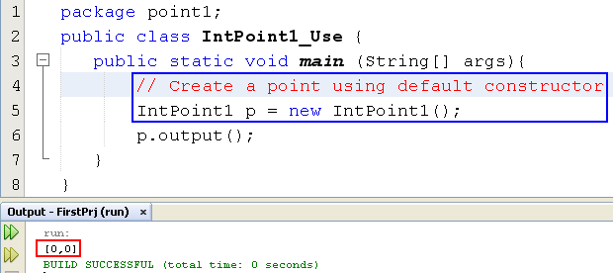
Demo: If we do not implement any constructor, compiler will insert to the class a default constructor
System constructor will clear all bits in allocated memory
Order for initializing an object
(2) Setup values
y
0
100
x
0
(1) Memory allocation
An object variable is a reference
p
100

Slide 26

Demo: If we implement a constructor, compiler does not insert default constructor
This demonstration will depict:
- The way to insert some methods automatically in NetBeans
- If user-defined constructors are implemented, compiler does not insert the system default constructor

Slide 27
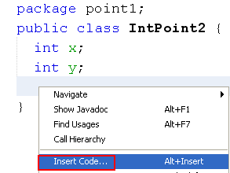
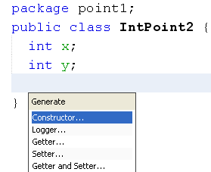
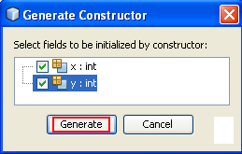
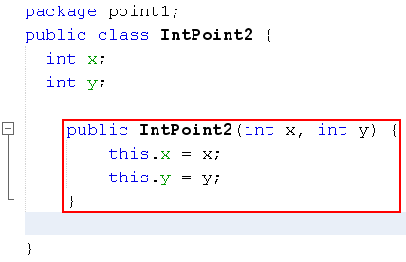
Demo: If we implement a constructor, compiler does not insert default constructor
Insert constructor
Parameter names are the same as those in declared data filed. So, the keyword this will help distinguish field name and parameter name.
this.x means that x of this object

Slide 28
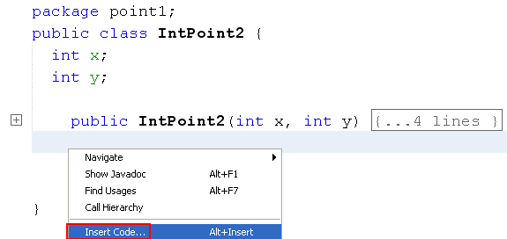
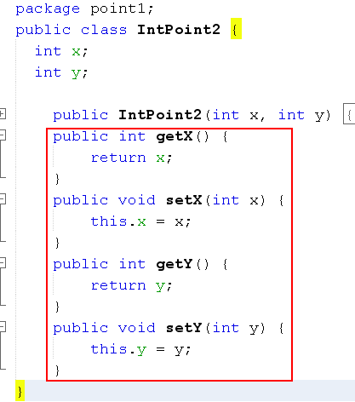
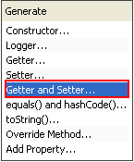
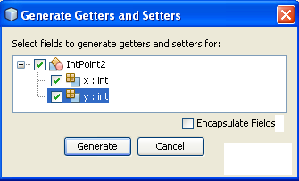
Demo: If we implement a constructor, compiler does not insert default constructor
Accessing each data field is usually supported by :
A getter for reading value of this field
A setter for modifying this field
Insert getter/setter

Slide 29
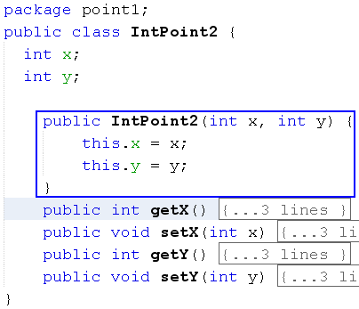
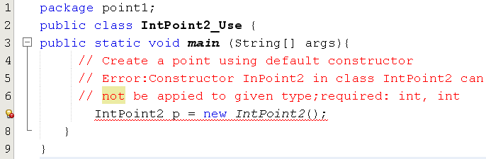
Demo: If we implement a constructor, compiler does not insert system constructor

Slide 30
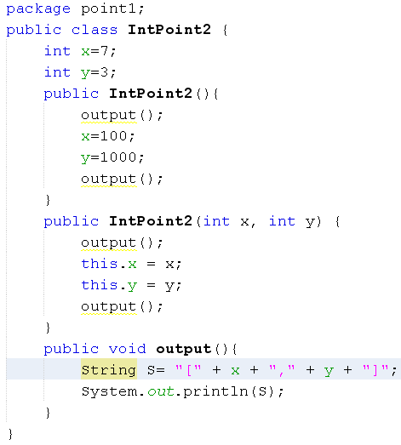
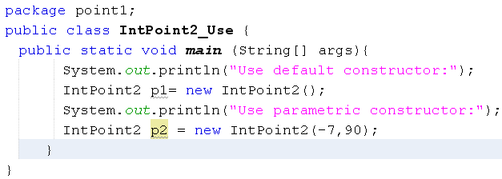
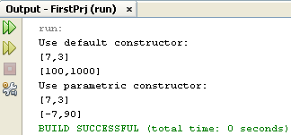
Explain the result of the following program

Slide 31


Lab

Slide 32
Common Modifiers
Modifier (linguistics)is a word which can bring out the meaning of other word (adjective →noun, adverb → verb)
Modifiers (OOP) are keywords that give the compiler information about the nature of code (methods), data, classes.
Java supports some modifiers in which some of them are common and they are called as access modifiers (public, protected, default, private).
Common modifiers will impose level of accessing on
class (where it can be used?)
methods (whether they can be called or not)
fields (whether they may be read/written or not)

Slide 33
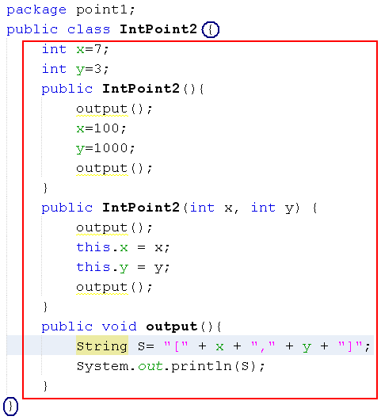
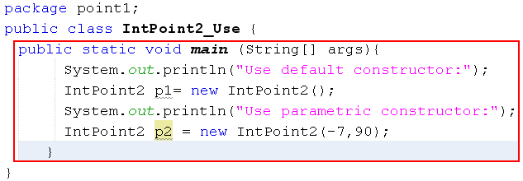
Outside of a Class
Inside of the class InPoint2_Use and it is outside of the class IntPoint2
Inside of the class InPoint2
Outside of the class A is another class where the class A is accessed (used)

Slide 34




Common Modifiers
Access level
Applied to
Free-accessing
public
interface
package/ subclass
protected
class
outside cannot access
private
members of
interface/class
package
no specifier
(default)
Interface is a group of prototyped methods and they will be implemented in a class afterward. It will be introduced later.
Order:
public > protected > default > private
Notes:
-Đối với interfae : khai báo fields -> private và protected không dùng được ; khai báo methods : protected không dùng được , privare : ok

Slide 35
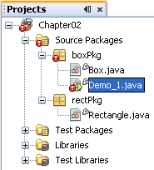
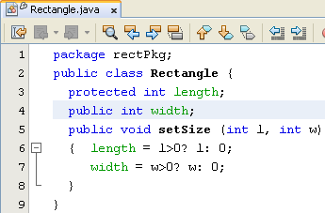
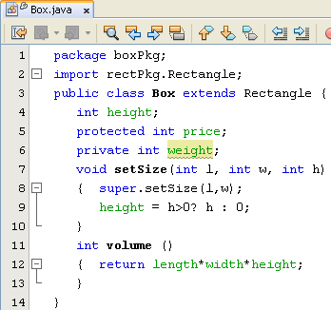
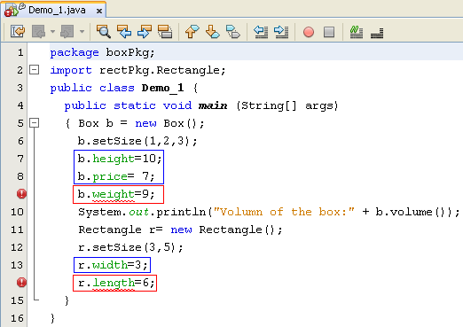
Common Modifiers
super: Keyword for calling a member declared in the father class.
If contructor of sub-class calls a constructor of it’s father using super, it must be the first statement in the sub-class constructor.

Slide 36
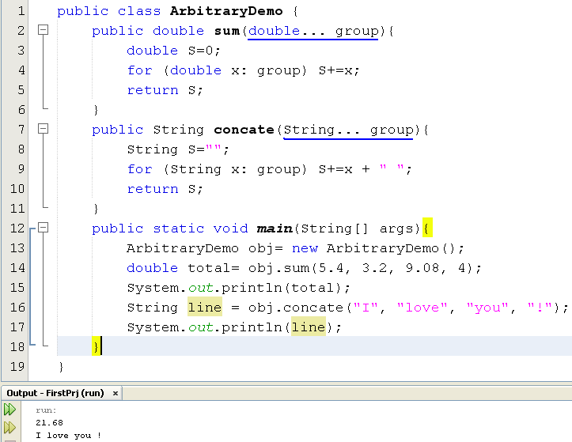
Demo: Methods with Arbitrary Number of Arguments
A group is treated as an array
group.length →number of elements
group[i]: The element at the position i

Slide 37
Demo: Methods with Arbitrary Number of Arguments
public class DemoArbitrary {
static int sum(int...group){
int s = 0;
for (int i : group) {
s+=i;
}
return s;
}
static int sum01(int...group,int x){
int s = 0;
for (int i : group) {
s+=i;
}
return s;
}
public static void main(String[] args) {
int a[] = {1,2,3};
int s = sum(a);
System.out.println(s);
s = sum(3,4,5);
System.out.println(s);
s = sum01(1,2,3,4);
System.out.println(s);
}
}

Slide 38
Case study
Problem: A sports car can be one of a variety of colours, with an engine power between 100 HP and 200 HP. It can be a convertible or a regular model. The car has a button that starts the engine and a parking brake. When the parking brake is released and you press the accelerator, it drives in the direction determined by the transmission setting.

Slide 39
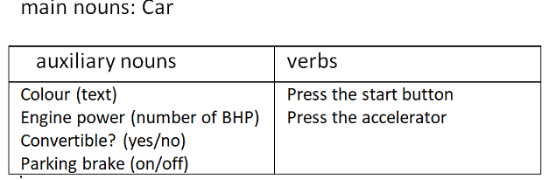
Report…
Class Design
From the problem description, concepts in the problem domain are expressed by following classes:

Slide 40
Report…
A UML class diagram is used to represent the Car class
Car
- Colour: String - EnginePower: int - Convertible: boolean - parkingBrake: boolean
+Car() +Car(String, int, boolean, boolean ) +pressStartButton():void +pressAcceleratorButton(): void + getColour(): String + setColour(String): void …

Slide 41
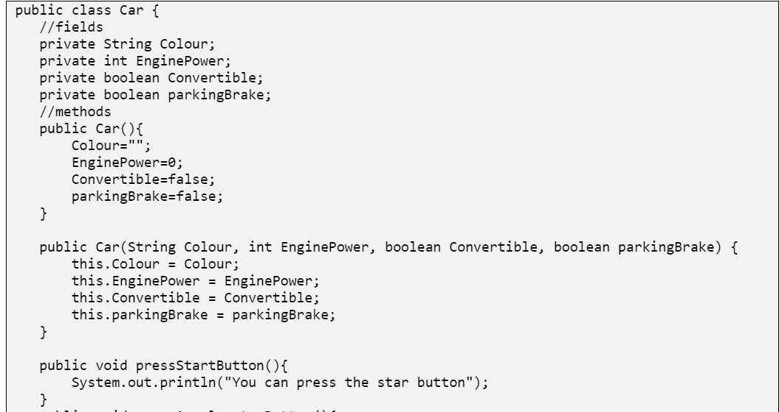
Implement

Slide 42
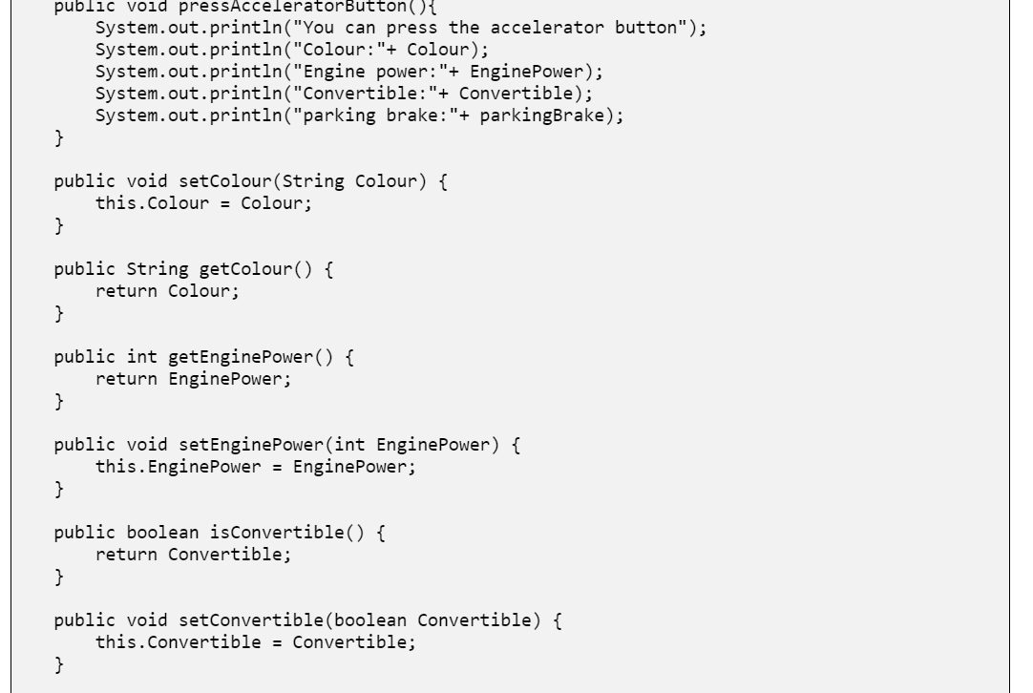
Implement

Slide 43
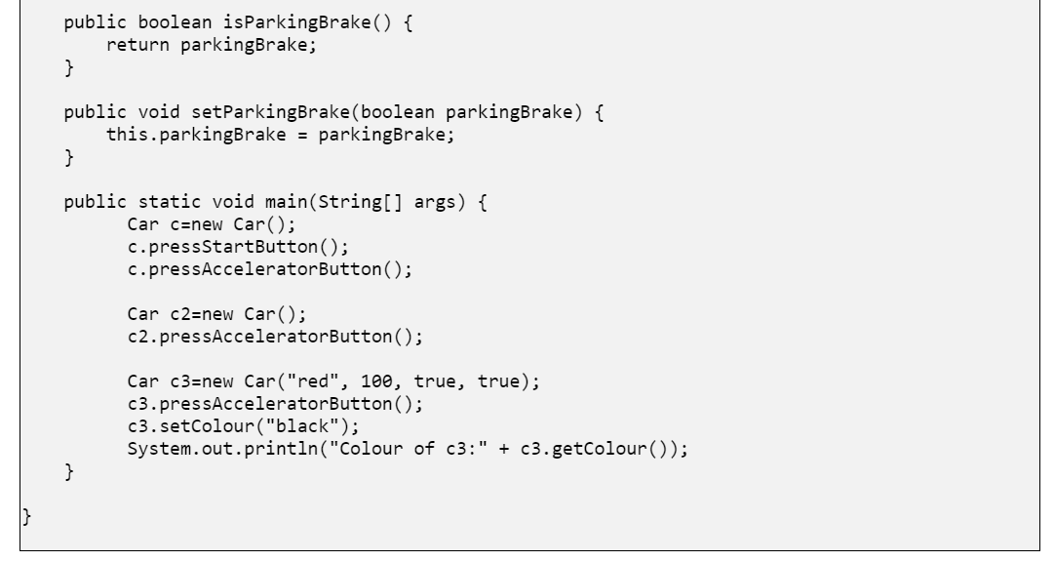
Implement

Slide 44
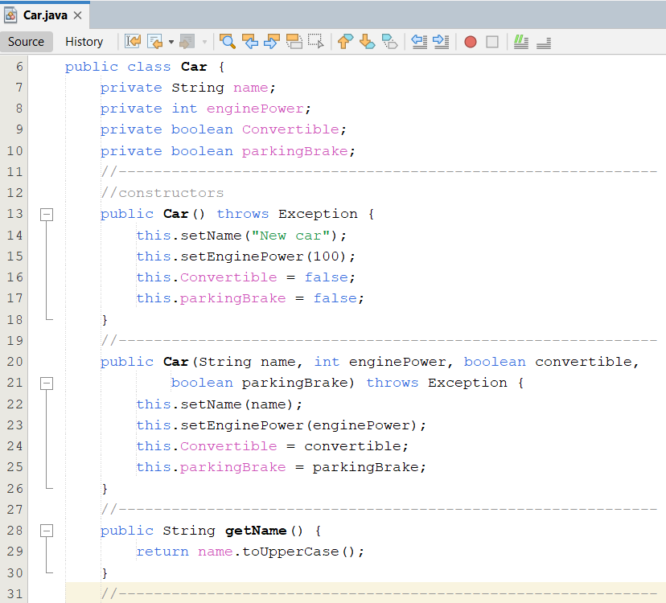
Implement…

Slide 45
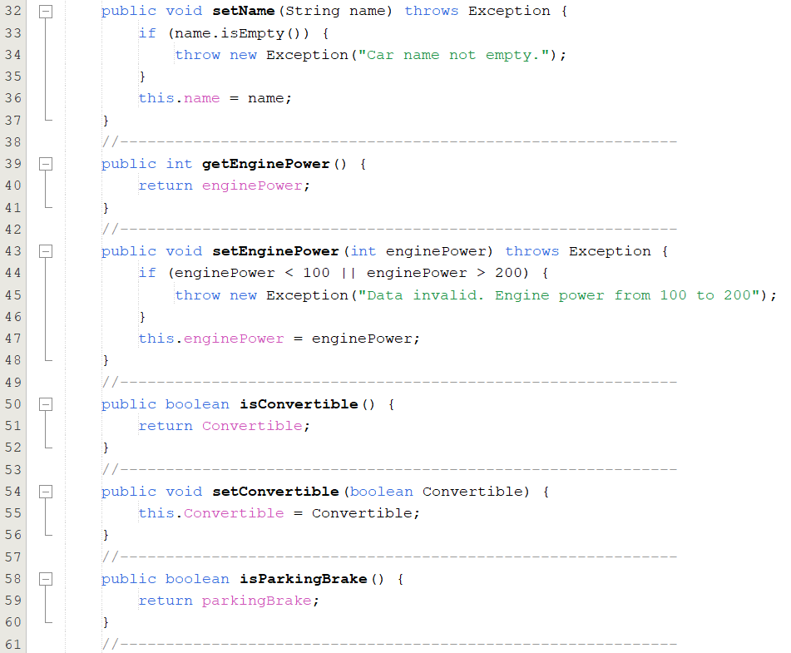

Slide 46
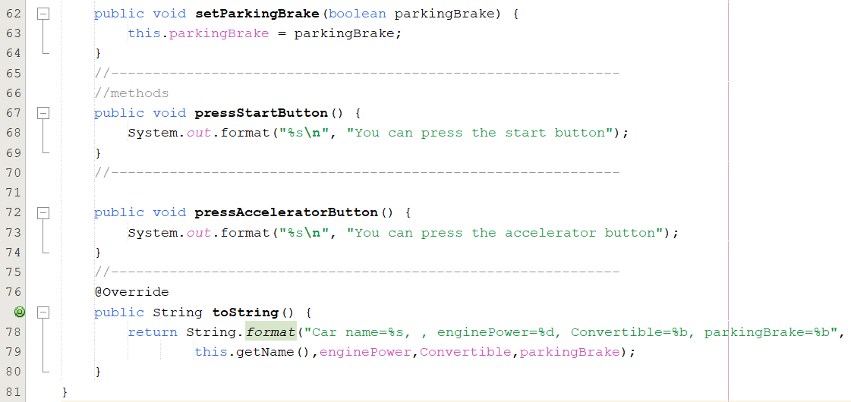

Slide 47
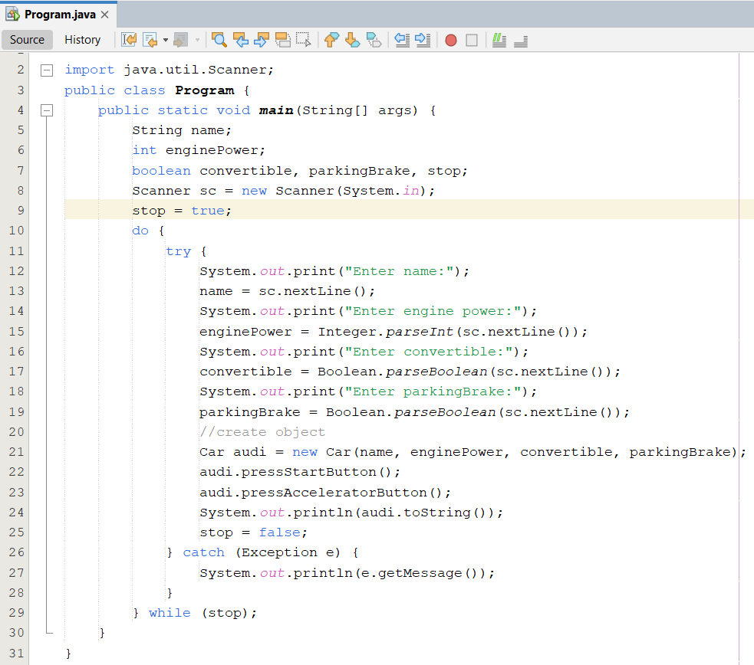

Slide 48
Summary
The anatomy of a class, and how to declare fields, methods, and constructors.
Hints for class design:
Main noun → Class
Descriptive nouns → Fields
Methods: Constructors, Getters, Setters, Normal methods
Creating and using objects.
To instantiate an object: Using appropiate constructior
Use the dot operator to access the object's instance variables and methods.

